Slide 1
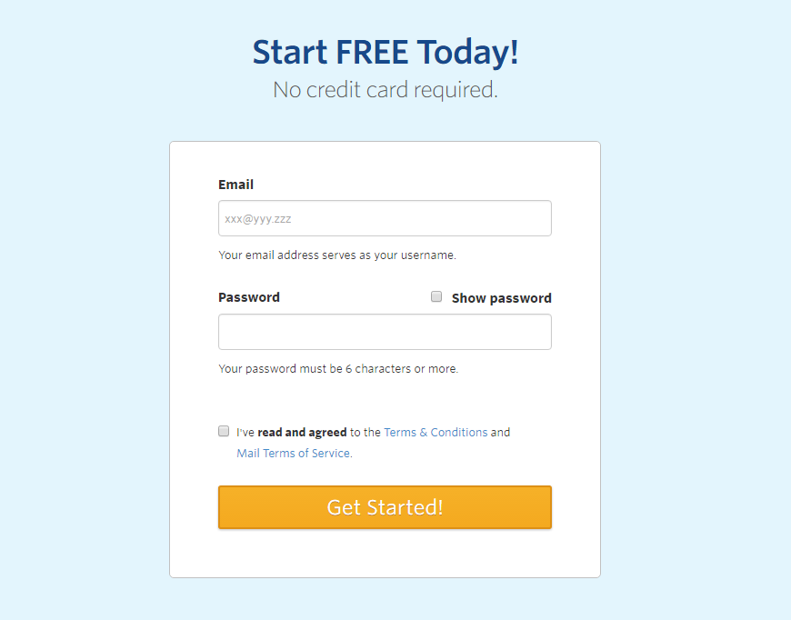
Step-1 Sign up for constant contact and verify your email

Slide 2
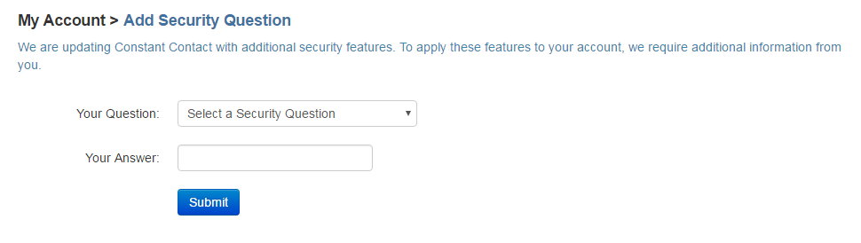
Step-2 Add security Question

Slide 3
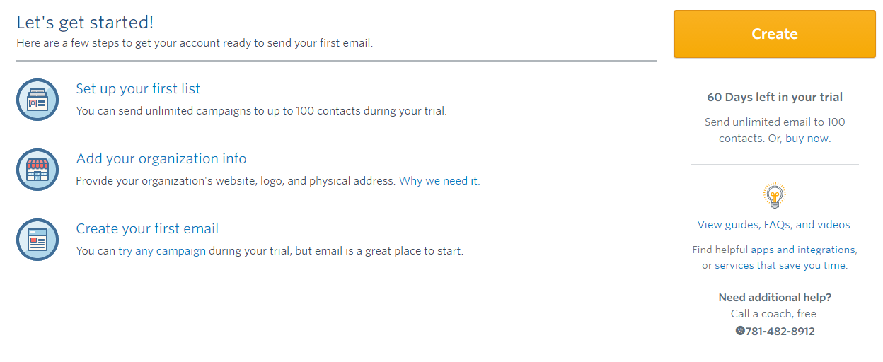
Step-3 Set up your first list

Slide 4
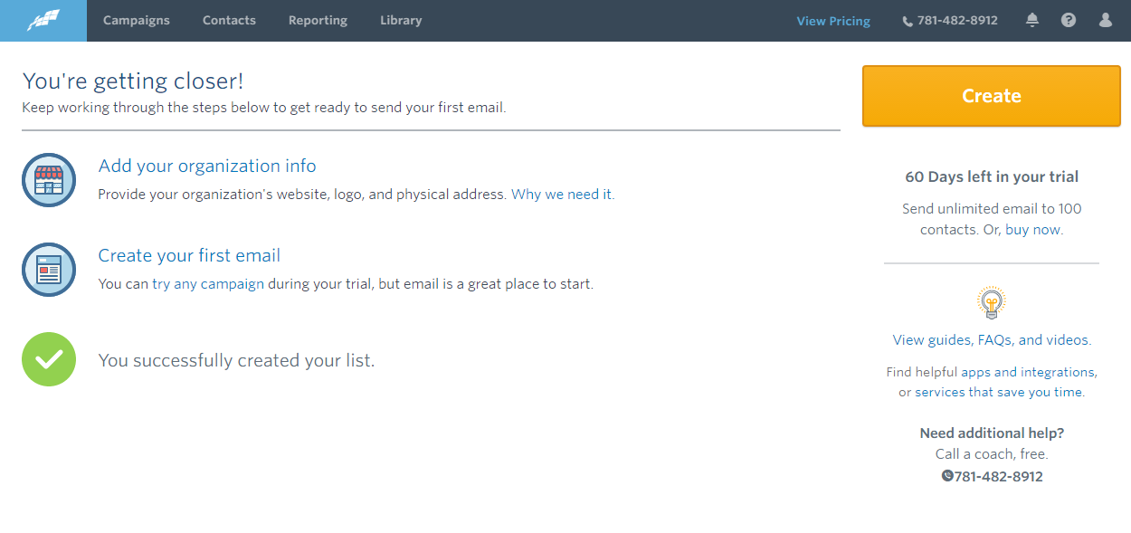
Step-4 Contacts
Click here

Slide 5
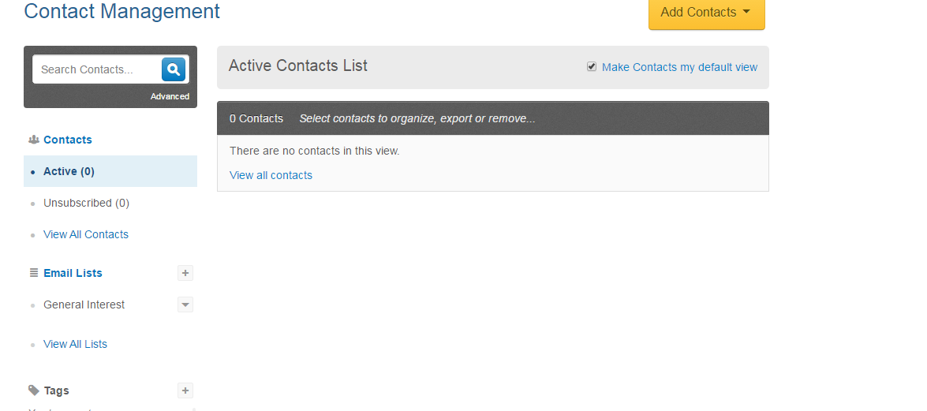
Step-5 Email List
Click Here

Slide 6
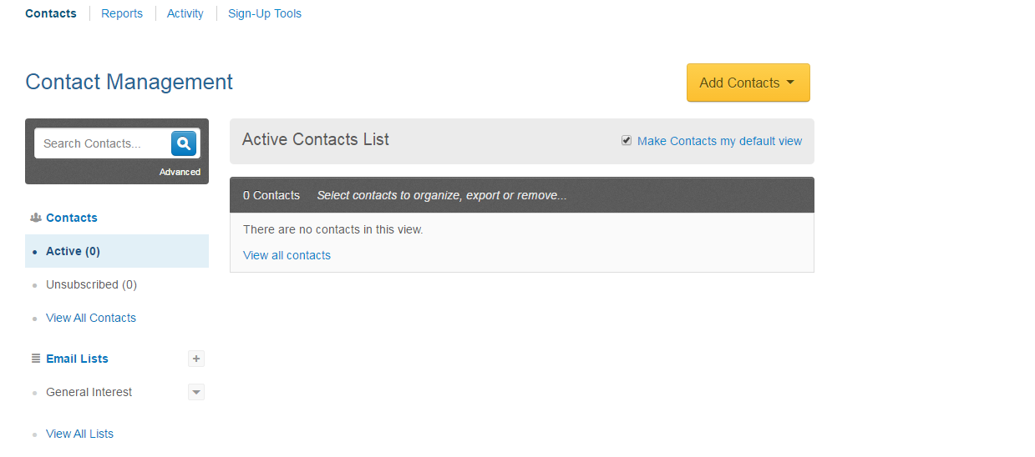
Step-6 Sign-Up Tools
Click Here

Slide 7
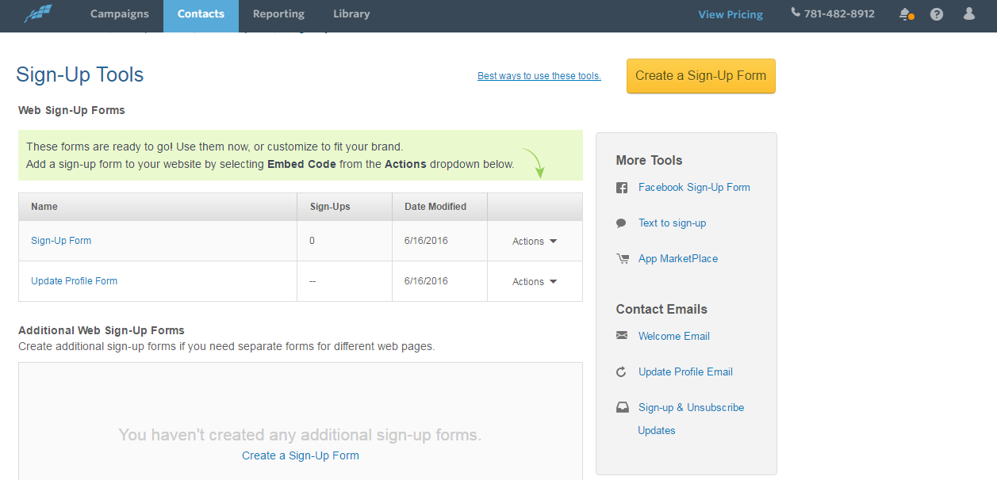
Step-7 Sign-Up Form
Click Here

Slide 8
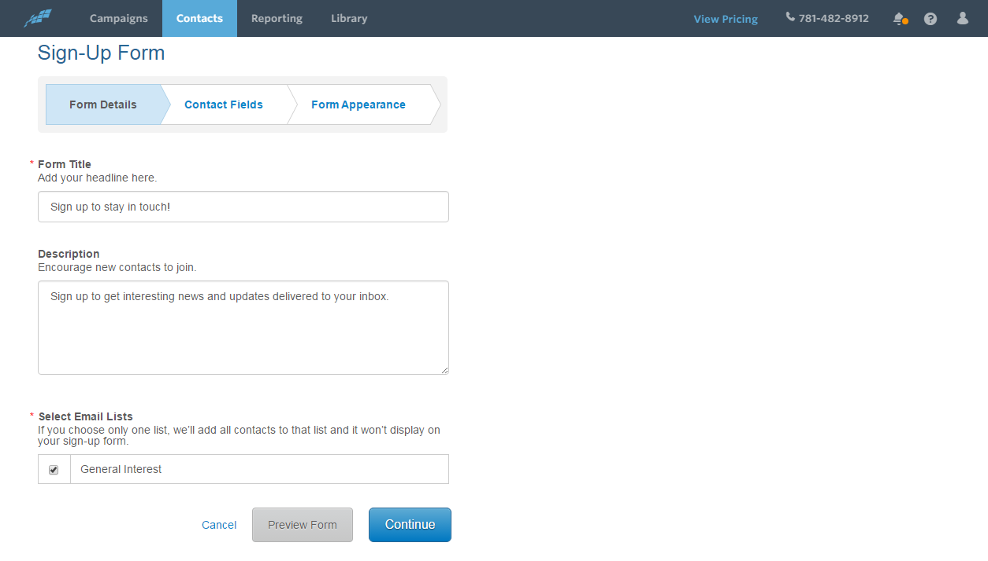
Step-8 Sign-Up Form
Setup your form and then continue

Slide 9
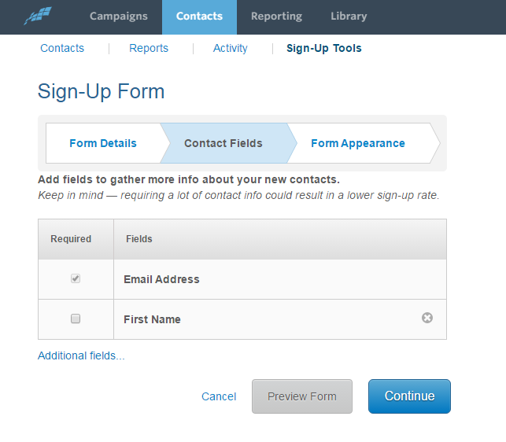
Step-9 Sign-Up Form
Then continue

Slide 10
Step-10 Sign-Up Form
Then continue

Slide 11
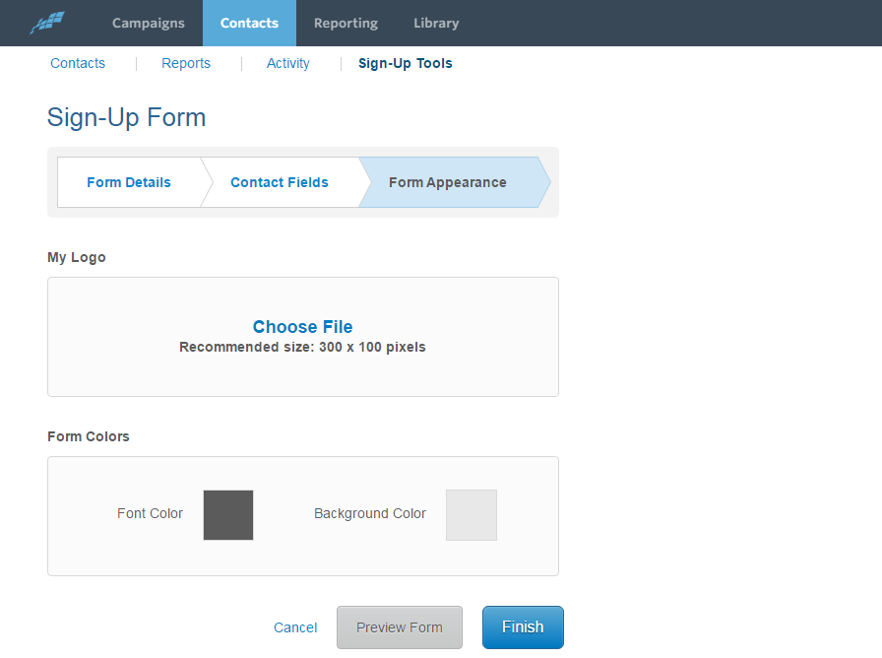
Step-11 Sign-Up Form
Then Finish

Slide 12
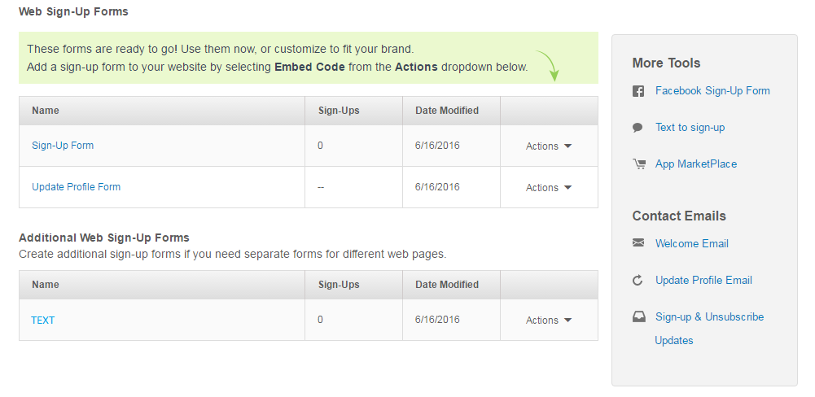
Step-12 Sign-Up Form
Click Here

Slide 13
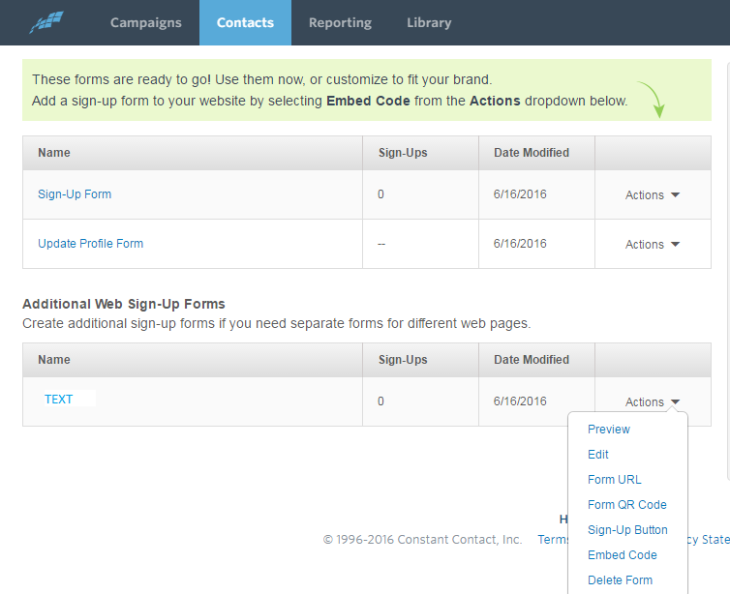
Step-13 Sign-Up Form
Click Here

Slide 14
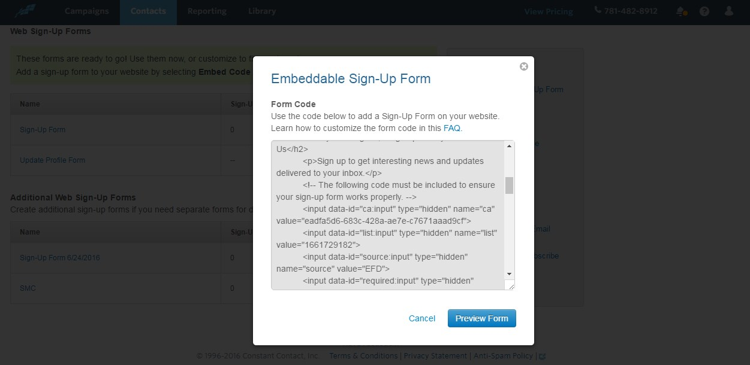
Step-14 Sign-Up Form
Copy the CA number and paste in the admin

Slide 15
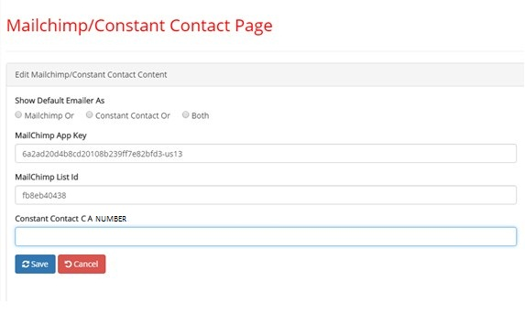
Step-15 Constant Contact Page
Paste the copied CA Number

